Slide 1
Concurrency control
CS460
Systems for Data Management and Data Science
Prof. Anastasia Ailamaki
Data-Intensive Applications and Systems (DIAS) Lab

Slide 2
Today’s topic
Data science software stack
Data Processing
Transaction
Management
Graph Data
Pregel, GraphLab, X-Streem, Chaos
Structured Data
Spark SQL
Machine Learning
Gossip Protocols
Query Execution
Batch Data
Map Reduce, Dryad, Spark
Streaming Data
Storm, Naiad, Flink, Spark Streaming Google Data Flow
Consistency protocols
CAP Theorem
Data Storage
Storage Hierarchies & Layouts
Distributed File Systems
(GFS)
NoSQL DB
Dynamo
Big Table Cassandra
Distributed Messging systems
Kafka
Distributed/Decentralized systems
Ressource Management & Optimization
Query optimization
Scheduling (Mesos, YARN)
Notes:
With Orange, we denote more general topics that are applied across several systems and architectures, both in scale-up and scale-out deployments.

Slide 3
Outline
Transactions & Concurrency Control
  ACID & Transaction Schedules
  Concurrency control protocols
    Pessimistic
    Optimistic
  Multi-version concurrency control

Slide 4
Definition of transactions
A transaction (txn, or Xact) is a sequence of actions
that are executed on a shared database to perform some higher-level function.
Transactions are the basic unit of change
in the DBMS. No partial txns are allowed.
Notes:
Transactions are the basic unit of change in the DBMS. It is defined as “any one execution of a user program in the DBMS” (so the user’s task inside the system in contrast to the user program outside the DBMS which is the usual application) [COW BOOK]
This user program performs some function at a high level but at a low level it is composed by a sequence of actions
This abstraction was developed with two goals in mind, performance, through concurrency, and crash recovery. Therefore, “transactions are the foundation for concurrent execution and recovery from system failure in DBMSs” [COW BOOK]
We will expand more on this later in the lecture.

Slide 5
A quick reminder of ACID
Atomicity: Either all actions in the txn happen, or none.
Consistency: If each txn is consistent, and the DB starts consistent, it ends up consistent.
Isolation: Execution of one txn is isolated from other txns.
Durability: If a txn commits, its effects persist.
Notes:
We want correctness, concurrency and the ability for system recovery. Ideally, transactions satisfy the following four properties, which we call ACID.
Atomicity guarantees that the transaction will execute as an indivisible sequence of actions. It cannot occur only partially, it will either happen or not happen at all.
Consistency: guarantees that data must be valid according to all defined rules, including triggers, constraints, referential integrity, …
Isolation: guarantees that transactions seem as if they are executed in isolation to one another, so there are no side-effects from concurrency. So, this notion is the one most related to concurrency control
Durability: guarantees that once a transaction commits, its effects will persist. As an example, after the transaction commits, even if the system crashes, the updates survive.

Slide 6
Atomicity and Durability
A transaction might commit after completing all its actions, or it could abort (or be aborted by the DBMS) after executing some actions.
All transactions are atomic.
  A user can think of a txn as always executing all its actions in one step, or not executing any actions at all.
  DBMS logs all actions so that it can undo the actions of aborted transactions.
Durability also relies on logs
Notes:
How commercial DB ensure these 4 acid properties, and to which extent.
In terms of atomicity, DBMS offer the illusion that each transaction is either fully completed and its results are committed, or aborted at any point, and does not update the database at all. That is, each transaction appears to be executed in a single step which may succeed as a whole or fail as a whole.
We should not see any partial effects and the transaction should appear to execute as if it were a single step.
Of course, in practice, transactions are multi-step processes. So, when a transaction fails, we need to undo its partial effects.
For this, DBMS keep logs for their actions, which are records of all the updates. In case of an abort, DBMSs check the log and undo the actions of failed transactions.
Durability also utilizes on logs. On recovery, DBMSs check the log for completed transactions (commit log) and restore the changes.
OPTIONAL: Reasons for an abort
System anomaly/internal reason (then usually, abort and restart)
System crash
Transaction decides to abort for unexpected situation (disk read fails, or unexpected data or CC)

Slide 7
Consistency and Isolation
Each transaction must leave the database in a consistent state.
  DBMS will enforce some integrity constraints.
  Clearly, no semantic consistency.
Users submit transactions, and expect isolation -- each transaction executed by itself.
  Concurrency very important for performance: interleaving actions from different transactions.
  Net effect identical to executing all transactions one after the other in some serial order.
Notes:
How commercial DB ensure these 4 acid properties, and to which extend.
Consistency: DBMS will enforce some integrity constraints, such as referential integrity, triggers, and type constraints. User should make sure that semantic consistency is satisfied.
Isolation is a bit tricky because of concurrency. In the ideal DBMS, isolation is offered in the degree that the net effect is identical to executing all transactions one after the other in some serial order. DBMS do not enforce isolation in the strict sense. They instead provide the illusion of isolation, to a limited extend. In fact, the extend is typically configurable. (examples: serializable, repeatable reads, read committed, read uncommitted)

Slide 8
A note on concurrency
Several transactions arrive at (almost) the same time
Need to execute in parallel to fully utilize hardware
T1:
R(A)
R(B)
compute-something
W(C)
COMMIT
T2:
R(E)
R(A)
R(D)
compute-something
…
T3:
R(D)
compute-something
R(E)
…
User writes SQL queries.
Translated to actions!
Notes:
The DBMSs receive sets of transactions that arrive at almost the same time, expressed as SQL queries.
The queries are translated to a sequence of actions. We see 3 examples of such sequences in the slide. What happens is that the transactions read and write objects, perform computations based on the objects they read and eventually commit.
[In the context of DBMSs, we focus on reads and writes since that is where the interaction with the database occurs]
Modern CPUs support concurrency and parallelism and as a result we can execute actions for the different transactions concurrently in order to exploit the performance of our hardware. For example, in the animation we see that we have independent actions from different transactions executing at the same time. With dependencies it will be trickier.

Slide 9
Schedules
The DBMS gets as input a set of transactions and executes a schedule.
Schedule: a list of actions (reading, writing, aborting, or committing) from a set of txns
  All actions appear in the schedule
  The order in which two actions of a transaction T appear in a schedule must be the same as the order in which they appear in T.
Notes:
Concurrency means in the general case that actions from different transactions are interleaved. We get schedules of actions, which provide an order on the execution of the actions in the transactions, according to some constraints.
Concretely, a schedule is a list of actions, from a set of txns. All txn actions need to be contained in the schedule. Also, the order in which two actions of a transaction appear in a schedule must be the same as the order they appear in T.
For example, if T1 contains R(A) and then W(B), then R(A) must precede W(B) also in the schedule.

Slide 10
Example
T1: transfer $100 from B’s account to A’s account.
T2: credit both accounts with a 6% interest payment.
There is no guarantee that T1 will execute before T2 or vice-versa, if both are submitted together.
Actions of two transactions can interleave!
However, the net effect must be equivalent to these two transactions running serially in some order.
T1: BEGIN A=A+100, B=B-100 END
T2: BEGIN A=1.06*A, B=1.06*B END
Notes:
Let’s see an example of this schedule.
We have a transaction T1 for transferring 100$ from B’s account to A’s. So, what happens is that we increment A’s balance by 100 and then decrement B’s balance by 100
We have a transaction T2 for crediting both accounts with a 6% interest payment, so we multiply the balance of both A and B by 1.06
Our assumptions are that we do not know the order of execution for these transactions. The actions might even interleave. However, they should execute in a way that the result is equivalent to a schedule where they executed in a serial order.

Slide 11
Example (Contd.)
Consider a possible interleaving schedule:
This is OK. But what about:
The system’s view of the second schedule:
T1: A=A+100, B=B-100
T2: A=1.06*A, B=1.06*B
T1: A=A+100, B=B-100
T2: A=1.06*A, B=1.06*B
T1: R(A), W(A), R(B), W(B)
T2: R(A), W(A), R(B), W(B)
Time
Notes:
The first schedule is ok and is equivalent to executing first T1 and then T2 even though we are interleaving.
The second schedule is NOT equivalent to 2 transactions running serially in some order! So, it is bad!
To elaborate, A gets the interest after they receive the payment, while B first gets the interest and then pays for the money. So, they get will have more money at the end of the schedule compared to the case that their balance was decremented first. The isolation of the transactions is breached.
As we mentioned earlier, what’s important are the reads and writes. So, we can convert the schedules into low level actions as far as the system is concerned. Here we see the dependencies between Reads and Writes on A and B, and how the ordering is different. T1 updates A before T2 and for B it is the opposite

Slide 12
Scheduling Transactions
Serial schedule: Schedule that does not interleave the actions of different transactions.
Equivalent schedules: For any database state, the effect (on the set of objects in the database) of executing the first schedule is identical to the effect of executing the second schedule.
Serializable schedule: A schedule that is equivalent to some serial execution of the transactions.
If each transaction preserves consistency, every serializable schedule preserves consistency.
Notes:
So, now that we have shown what we want to achieve and what we want to avoid, let’s get some definitions out
First, let’s define a serial schedule. This is simply a schedule in which we do not interleave any transactions at all.
Equivalent schedules means that the effect of executing two schedules on the database, for any database state, is identical
Now, based on our description, we want schedules that are equivalent to serial schedules. We call those serializable
A good property of serializable schedules is that if individual transactions preserve consistency, the same holds for the serializable schedule

Slide 13
Anomalies with Interleaved Execution
Reading Uncommitted Data (WR Conflicts, “dirty reads”):
Unrepeatable Reads (RW Conflicts):
Overwriting Uncommitted Data (WW Conflicts):
T1: R(A), W(A), R(B), W(B), Abort
T2: R(A), W(A), C
T1: R(A), R(A), W(A), C
T2: R(A), W(A), C
T1: W(A), W(B), C
T2: W(A), W(B), C
Time
Notes:
Read only transactions cause no problems. We can reorder them as we see fit. Problems occur when we have writes.
Why is interleaved transaction execution problematic? The answer is conflict. We have 3 types of conflicts and all go against isolation property.
Generally, these are: W/W or R/W on the same object! Two or more reads are NOT conflicting
In the first example, we have the problem of reading uncommitted data (which happens with WR conflicts). We also call them dirty reads. A transaction reads an object written from another transaction that hasn’t committed yet. But then, what happens if the writer transaction aborts. The value in the read will be invalid.
In the second example, we have the problem of unrepeatable reads caused by RW conflicts. T1 reads a value of A and then tries to re-read it. However, in the meantime, T2 has written a new value for A and has even committed (so it is no dirty read). So, T1 will read a different value and that can cause problems.
In the third example, we overwrite uncommitted data (with WW conflicts). Now what happens here is that at the end, we will have the value of B written by T1 and the value of A written by T2. This is not equivalent by any serial schedule

Slide 14
Aborting a Transaction
If T_{i} is aborted, all its actions have to be undone.
Cascading aborts: If T_{j} reads an object last written by T_{i}, T_{j} must be aborted as well!
  Alternative to avoid cascading aborts: If T_{i} writes an object, T_{j} can read this only after T_{i} commits.
DBMS maintains a write log, in order to be able to undo the actions of aborted txns.
  Also used to recover from system crashes: all active txns at the time of the crash are aborted when the system comes back up.
Notes:
When a conflict is detected, we need to abort a transaction! This means that we must undo all actions (rollback)
However, the impact is sometimes more than just a rollback. We can have cascading transactions. For example, a transaction Tj might read an uncommitted object from Ti. If Ti aborts, then Tj should also abort. In this case, the aborts can be quite expensive overall.
To avoid that, we can use a mechanism that only allows reading Tj to read objects that have only been committed.

Slide 15
Conflict Serializable Schedules
Two schedules are conflict equivalent if:
  They involve the same actions of the same transactions
  Every pair of conflicting actions is ordered the same way
  i.e., we can transform one into the other by swapping non-conflicting adjacent operations
Schedule S is conflict serializable if:
  S is conflict equivalent to some serial schedule.
  Intuition: You can transform S into a serial schedule by swapping consecutive non-conflicting operations of different transactions
Notes:
Conflict equivalent:
-actions from same transactions
-conflicts in same order
-we can transform one to the other with swaps of actions (if conflicts allow it)
Conflict serializable: a stricter definition of serializability (computationally easier to detect)
Conflict serializable => serializable
(exception at end of notes)
EXAMPLE:
Conflicting actions: W/W or R/W on the same value!
Conflict serializable important because order of conflicting actions determines the final result → if conflict serializable, then FINAL results are the same as serial schedule!
T1 T2
R(A)
R(A)
W(B)
C
W(A)
C
This schedule is conflict-equivalent to the serial schedule T1->T2
T1 T2 T3
W(A)
W(A)
W(A)
W(A)
Serializable yes, conflict serializable no. Equivalent serial schedule will be either T2->T3->T1 or T3->T2->T1.

Slide 16
Example
A schedule that is not conflict serializable:
Precedence graph: One node per txn; edge from T_{i} to T_{j} if T_{j} reads/writes an object last read/written by T_{i}.
The cycle in the graph reveals the problem. The output of T1 depends on T2, and vice-versa.
T1: R(A), W(A), R(B), W(B)
T2: R(A), W(A), R(B), W(B)
A
Dependency graph
a.k.a. precedence graph
T1
T2
B
Notes:
We see an example of a schedule that is not conflict serializable:
T1 and T2 have a W-R conflict on A
Also they have a W-R conflict on B on the opposite direction
To formalize the detection of conflict serializability, we can create a dependency graph based on the conflicts
There is an edge from T1 to T2 because of the W-R conflict on A
There is an edge from T2 to T1 because of the W-R conflict on B
So now we have a cycle, this shows that the schedule is not conflict serializable

Slide 17
Precedence Graph
Also known as dependency graph/ serializability graph
Precedence graph: One node per txn; edge from T_{i} to T_{j} if T_{j} reads/writes an object last read/written by T_{i}.
Theorem: A schedule is conflict serializable if and only if its dependency graph is acyclic
Notes:
The theorem proves exactly this point. Conflict serializable schedules ⬄ dependency graphs are acyclic
The ”last read/written” is a convention. Other conventions involve any preceding transaction Ti which has a conflicting action with Tj

Slide 18
Outline
Transactions & Concurrency Control
  ACID & Transaction Schedules
  Concurrency control protocols
    Pessimistic
    Optimistic
  Multi-version concurrency control

Slide 19
Concurrency protocols
Two-phase locking (2PL)
  Pessimistic approach
  Assume txns will conflict!
  Acquire locks on items before accessing them!
Notes:
Serializability and concurrency are major issues! Accordingly, there is quite a lot of work on these topics.
One direction of this work that we will focus on now incudes development of concurrency protocols. That is, PROTOCOLS that focus that we will be executing only conflict-serializable schedules which will maintain the correctness of our data (AS MUCH AS POSSIBLE).
We will start with two-phase locking which is a pessimistic approach. Here, we assume that accesses to the same object lead to conflicts. Therefore, we avoid conflicts by locking items before accessing them.
In order to ensure conflict serializability, we still enforce some rules in the protocol.

Slide 20
Lock-Based Concurrency Control
Transactions acquire locks before reading and writing
Locking protocol guarantees that schedule will be conflict serializable (correct) if it completes
  Deadlocks are possible
Locking granularity can be anything
  Tables, indexes, pages, records
Notes:
First, let’s consider lock-based Concurrency control (CC) in general
The model is that transactions require locks before reading or writing to objects
If the transactions are executed in a way that adheres to the protocol and they terminate, the resulting schedule is going to be conflict serializable.
The termination condition stems from the fact that deadlocks are possible. We will see more about them soon.
Another thing to note is that the granularity of locks varies. We can lock whole tables, we can lock indexes, pages or records. The correct granularity depends on the use case.

Slide 21
Lock-Based Concurrency Control
Two-Phase Locking (2PL) Protocol
Rule 1: Each txn obtains
  S (shared) lock before reading
  X (exclusive) lock before writing
  Sometimes also called read/write locks
Rule 2: A txn cannot request additional locks once it releases any locks.
2PL allows only schedules whose precedence graph is acyclic => serializable.
Time
Example schedule with locks:
T1: S(A) R(A) S(B) R(B)
T2: X(C) R(C) W(C) S(D) R(D)
Time
Notes:
The 2PL protocol has two rules
We need to acquire to correct type of lock depending on whether we want to read or write the object (this way we have finer grained locking and we can have multiple readers so increased concurrency/performance)
We cannot request new locks after we have released notes. This means that there are two phases. A first phase when we start collecting locks and a second phase when we start releasing locks.
The resulting schedule is conflict serializable
We see an example for two txns T1, T2 that adhere to the protocol. S and X denote shared and exclusive locks respectively.

Slide 22
Lock-Based Concurrency Control
Two-Phase Locking (2PL) Protocol
Rule 1: Each txn obtains
  S (shared) lock before reading
  X (exclusive) lock before writing
  Sometimes also called read/write locks
Rule 2: A txn cannot request additional locks once it releases any locks.
2PL allows only schedules whose precedence graph is acyclic => serializable.
Strict Two-phase Locking (Strict 2PL) Protocol
Rule 3: All locks released when the txn completes.
Strict 2PL additionally simplifies transaction aborts
  (Non-strict) 2PL involves more complex abort processing.
Time
Time
Notes:
A variant is the strict 2PL. Here, we only release the locks with commit.
(Non-strict) 2PL involves more complex abort processing because strict 2pl does not need cascading aborts.

Slide 23
Deadlocks
Deadlock: Cycle of transactions waiting for locks to be released by each other.
Two ways of dealing with deadlocks
  Deadlock detection: detect and resolve deadlocks when they are created.
  Deadlock prevention: never let deadlocks happen.
Notes:
Because of locking, deadlocks can occur.
For example, we can have a txn T1 lock an object A and wait for a lock on object B, while a txn T2 locks B and waits for a lock on A. More complex deadlocks can also occur.
This would normally cause the transactions to never terminate. To deal with the problem, we either detect and resolve deadlocks when they are created, or take measures to prevent deadlocks from happening

Slide 24
Deadlock Detection
If a lock request cannot be satisfied, the transaction is suspended and must wait until the resource becomes available.
Create a waits-for graph:
  Nodes are transactions
  Edge from T_{i} to T_{j} if T_{i} is waiting for T_{j} to release a lock
Periodically check for cycles in the waits-for graph
Notes:
Locks are usually implemented by suspending the txn in question until the requested resource protected by the lock is available by then
Now, in order to detect deadlocks, we need to keep track of the resources that each transaction is waiting for => waits-for graph
Nodes are txns
(Ti,Tj) means that Ti is waiting for Tj to release a lock
A cycle means that there is a deadlock. So the execution of the transactions cannot resume.
We need to detect cycles in the wait-for graph and resolve them. We do that periodically.

Slide 25
Deadlock Detection (Continued)
Example:
T1: S(A) R(A) S(B)
T2: X(B) W(B) X(C)
T3: S(C) R(C) X(A)
T4: X(B)
T1
T2
T1
T2
T4
T3
T4
T3
Notes:
Let’s look at an example for 4 transactions.
We see the schedule on the top and at the bottom the wait for graphs before and after T3 acquires an exclusive lock for object A.
Before that action, the graph is acyclic, there are no cycles. But once T3 requests the lock, then T3 waits for T1 on A, T1 waits for T2 on B and T2 waits for T3 on C. So, we get a deadlock. To avoid that, we will have to abort one of the three transactions in the next periodic check.

Slide 26
Deadlock Prevention
Assign priorities based on timestamps.
  Earlier timestamp → higher priority
Assume T_{i} wants a lock that T_{j} holds.
Two policies:
  Wait-Die (“old waits for young”):
    If T_{i} has higher priority, T_{i} waits for T_{j}. Otherwise T_{i} aborts
  Wound-wait (”young waits for old”):
    If T_{i} has higher priority, T_{j} aborts. Otherwise T_{i} waits
If a transaction re-starts, make sure it has its original timestamp
Notes:
The alternative is to avoid creating the deadlock at all. So, we don’t have to check the wait-for graph in retrospect.
An option is to use a priority scheme based on timestamps so the txns that started first have higher priority.
Then, on locking, if Ti tries to acquire a lock that Tj holds, we can choose one of two strategies:
If Ti has higher priority, it waits for Tj, otherwise it aborts. This is wait-die strategy
If Ti has a higher priority, Tj aborts, otherwise Ti waits. That’s wound-wait
Why do these two strategies resolve cycles?
This enforces a timestamp ordering within the cycle (for example T1 < T2 < T3) so because of the monotonicity, the cycle cannot be completed. The txn will be aborted instead.
Also, why if a transaction re-starts, make sure it has its original timestamp? Which problem does this solve?
We make sure that it will eventually have the highest priority and terminate

Slide 27
Fixed vs dynamic databases
Fixed tuples
  Set of tuples is fixed
  Can update, but no inserts/deletes
  Can lock all related tuples
UPDATE employees
SET salary=salary*1.2 WHERE age>60
Dynamic databases
  Can insert/delete tuples
  Cannot lock all related tuples
  INSERT INTO employees(name,age,salary)
  VALUES(“Superman”, 62, 10000)
Notes:
The model that we described so far works well if the set of tuples is fixed and we only have updates. We can lock all the related tuples.
But we can have dynamic databases. We insert/delete tuples in them and therefore locking all related tuples is not possible at any point in time. So, how do techniques such as 2PL work out?

Slide 28
Dynamic Databases
If insertions/deletions are allowed, then even Strict 2PL cannot assure serializability
  T1: Print the oldest sailors with rating=1 and rating=2
  T2: Insert a sailor with (rating=1,age=96), and delete the oldest sailor with rating=2
  The results may not correspond to a serial execution → not conflict-serializable!
Notes:
In this scenario, strict 2pl cannot guarantee serializability
Let’s look at an example. Next slide explain why it is not conflict serializable

Slide 29
Dynamic Databases
If insertions/deletions are allowed (not only updates), then even Strict 2PL cannot assure serializability
  T1 locks all pages containing sailor records with rating = 1, and finds oldest sailor (age = 71).
  Next, T2 inserts a new sailor; rating = 1, age = 96.
  T2 also deletes oldest sailor with rating = 2 (age = 80), and commits.
  T1 now locks all pages containing sailor records with rating = 2, and finds oldest (age = 63).
Not conflict serializable!!!
T1: S(A*) R(A*) S(B*) R(B*) W(C)
T2: X(A’) I(A’) X(B) D(B)
Notes:
if serializability: T1 and then T2:
T1 prints 71,80 and then T2 inserts 96, deletes 80
if T2 and then T1
T2 inserts 96, deletes 80 and then T1 prints 96, 63
The two resulting sailors where never the oldest for their rating at the same time, at any point (with any ordering of the transactions)

Slide 30
How did serializability break aka “The phantom menace”
T1 implicitly assumes that it has locked the set of all sailor records with rating = 1.
  Assumption only holds if no sailor records are added while T1 is executing!
Conflict serializability guarantees serializability only if the set of objects is fixed!
Need some mechanism to enforce this assumption.
  (Index locking and predicate locking).
Notes:
T1 assumes that there are no other txn is adding records while it is executing.
Let us next see someways of handling this issue.

Slide 31
Predicate Locking
Implicitly lock all records (also new) that satisfy a logical predicate
  I.e., rating=1 or rating=2.
How would you implement predicate locking?
  Very expensive
Notes:
The solution to the problem is to lock all records that satisfy a logical predicate. So, we can lock even when the set of objects is not fixed
But doing that is normally very expensive. All records need to be checked against all locked predicates. However, we already have indices which map the physical storage to logical properties

Slide 32
Index Locking
T1 locks the index pages containing the data entries with rating = 1 and rating = 2.
  Index needs to be updated after the insert → will fail if locked
  If there are no records with rating = 1, T1 must lock the index page where such a data entry would be, if it existed!
Special case of predicate locking – more efficient implementation.
Notes:
So, instead of locking the predicates of rating = 1 and rating = 2, we can lock the index pages with the corresponding data entries.
Then, the insertions and deletions will stall until the locks are released.
There is still a fine point: what happens if there no entry with a specific value until the moment of locking?
Then we need to lock the page where the data entry WOULD be, IF IT EXISTED. then, again the locking will be effective.
Index locking is a special case of predicate locking, since logical locks can be even more complex. However, because of the index properties, it is also much more efficient to implement.

Slide 33
Are 2PL protocols always good?
Locking: Conservative approach in which conflicts are prevented.
Disadvantages
  Lock management overhead.
  Deadlock detection/resolution.
  Lock contention for heavily used objects.
If conflicts are rare, gain concurrency by not locking, and instead checking for conflicts before txns commit
Notes:
Locking is a pessimistic/conservative approach. It prevent conflicts and works best when conflict are frequent
Managing locks has its cost
Deadlock detection and resolution is expensive and is paid for proactively
For heavily used objects we have lock contention
Lock thrashing: “locks cause delays because of waiting + lots of txns with lots of locks means lots of waiting => a lot of waiting means txn take longer and keep locks for more time “ (Andy Pavlo notes)
So we have lots of overhead. An optimistic scheme will allow for higher concurrency and less overhead if conflicts are rare. More on that soon

Slide 34
Outline
Transactions & Concurrency Control
  ACID & Transaction Schedules
  Concurrency control protocols
    Pessimistic
    Optimistic
  Multi-version concurrency control
Notes:
Until now we saw transactions, and then, lock-based concurrency control protocol (2PL and S2PL).

Slide 35
Concurrency protocols
Two-phase locking (2PL)
  Pessimistic approach
  Assume txns will conflict!
  Acquire locks on all items before accessing them!
Timestamp ordering (T/O)
  Optimistic approach
  Assume that conflicts are rare!
  Do not acquire locks, check for conflicts at commit!
Notes:
Problems with 2PL: Lock management overhead, deadlock detection overhead, lock contention overhead. WHAT IF the conflicts are rare…

Slide 36
Optimistic Concurrency Control
The Kung-Robinson Model
Key idea: Timestamp ordering is imposed on transactions, and validation phase checks that all conflicting actions occurred in the same order.
If this is not the case, abort the transaction that started later!

Slide 37
Kung-Robinson Model
Txns have three phases:
  READ: txns read from the database, but make changes to private copies of objects.
  VALIDATE: Check for conflicts.
  WRITE: Make local copies of changes public.
old
modified
objects
ROOT
new
Notes:
Empty boxes are the new private versions.
Then, at the write phase those are used to overwrite the old values.

Slide 38
Validation
Test conditions that are sufficient to ensure that no conflict occurred.
Each txn assigned a numeric id.
  Just use a timestamp.
  Txn ids assigned at end of READ phase, just before validation begins.
ReadSet(T_{i}): Set of objects read by txn T_{i}.
WriteSet(T_{i}): Set of objects modified by T_{i}.
Notes:
Ti completes (all three phases) before Tj begins; or
Ti completes before Tj starts its Write phase, and Ti does not write any database object that is read by Tj: This means that Tj does not rely on something that might have been updated by Ti. Why Tj write phase should not yet start? Because we need to be sure that Tj results DID not affect Ti
Ti completes its Read phase before Tj completes its Read phase, and Ti does not write any database object that is either read or written by Tj: This addresses the previous constraint, because we know that Tj cannot affect results of Ti!

Slide 39
Test 1
For all i and j such that T_{i} < T_{j}, check that T_{i} completes before T_{j} begins.
T_{i}
T_{j}
R
V
W
R
V
W
Notes:
Compare any two pairs of transactions (Ti, Tj): If Ti completes (all three phases) before Tj begins --> all ok

Slide 40
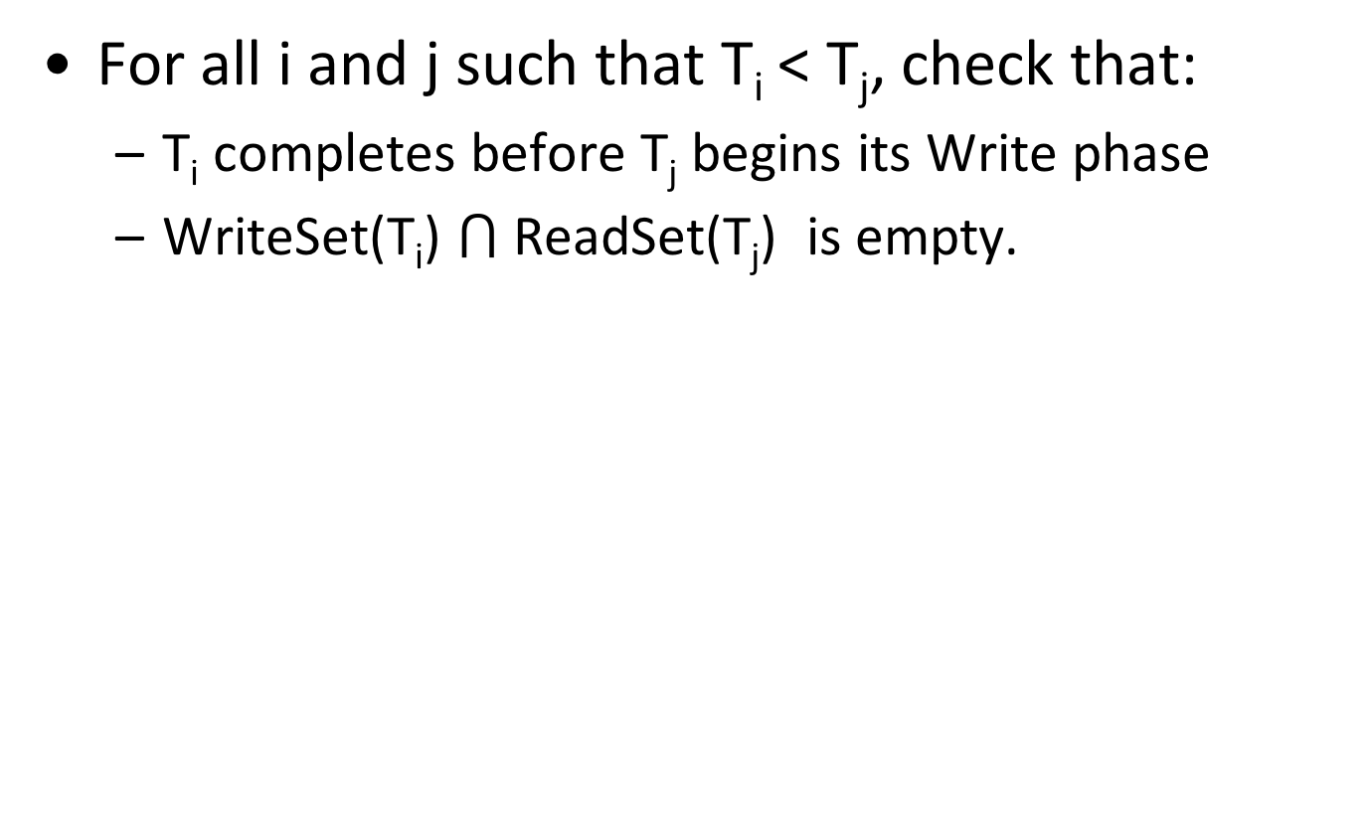
Test 2
For all i and j such that T_{i} < T_{j}, check that:
  T_{i} completes before T_{j} begins its Write phase
  WriteSet(T_{i}) $⋂$ ReadSet(T_{j}) is empty.
T_{i}
R
V
W
T_{j}
R
V
W
“Does T_{j} read dirty data?”
Notes:
Ti completes before Tj starts its Write phase, and Ti does not write any database object that is read by Tj: This means that Tj does not rely on something that might have been updated by Ti. Why Tj write phase should not yet start? Because we need to be sure that Tj results DID not affect Ti

Slide 41
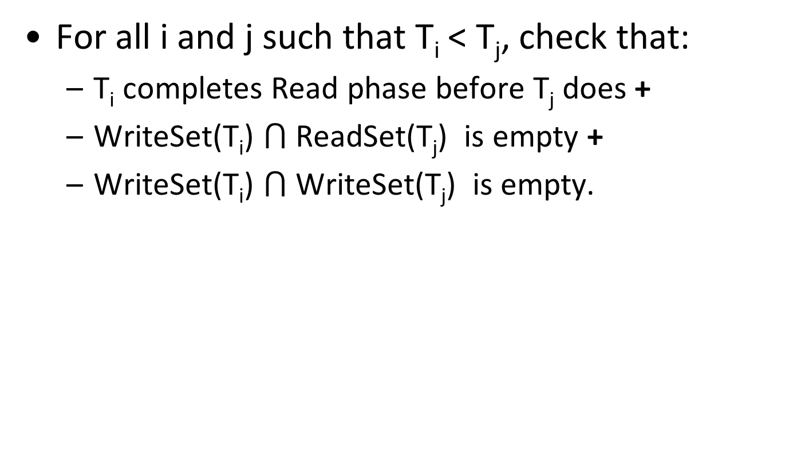
Test 3
For all i and j such that T_{i} < T_{j}, check that:
  T_{i} completes Read phase before T_{j} does +
  WriteSet(T_{i}) $⋂$ReadSet(T_{j}) is empty +
  WriteSet(T_{i}) $⋂$WriteSet(T_{j}) is empty.
T_{i}
R
V
W
T_{j}
R
V
W
“Does T_{j} read dirty data?”
“Does T_{i} overwrite T_{j}’s writes?”
Notes:
Ti completes its Read phase before Tj completes its Read phase, and Ti does not write any database object that is either read or written by Tj: This addresses the previous constraint, because we know that Tj cannot affect results of Ti!

Slide 42
Example: Optimistic CC
T1: R(A), W(A), R(B), W(B) C
T2: R(A), W(A), R(B), W(B) C
T1: R(A), W(A), R(B), W(B)
READ VALIDATE WRITE
T2: R(A), W(A), R(B), W(B)
READ VALIDATE WRITE

Slide 43
Example: Optimistic CC
T1: R(A), W(A), R(B), W(B)
READ VALIDATE WRITE
T2: R(A), W(A), R(B), W(B)
READ VALIDATE WRITE
Validation of T2:
  Test 1: ???
For all i and j such that T_{i} < T_{j}, check that T_{i} completes before T_{j} begins.

Slide 44
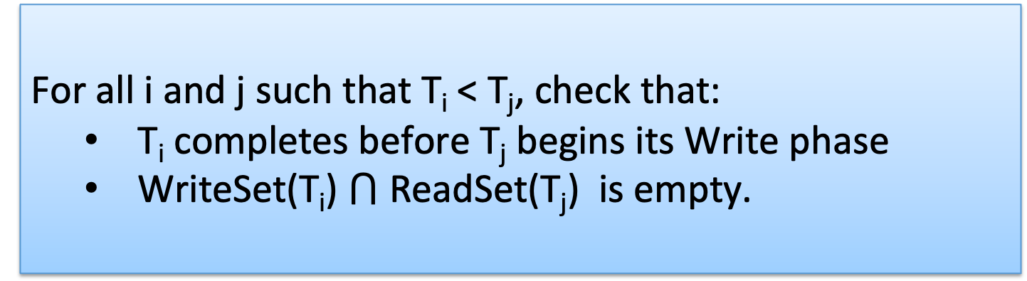
Example: Optimistic CC
T1: R(A), W(A), R(B), W(B)
READ VALIDATE WRITE
T2: R(A), W(A), R(B), W(B)
READ VALIDATE WRITE
Validation of T2:
  Test 1: fails Test 2: ???
For all i and j such that T_{i} < T_{j}, check that:
  T_{i} completes before T_{j} begins its Write phase
  WriteSet(T_{i}) $⋂$ ReadSet(T_{j}) is empty.

Slide 45
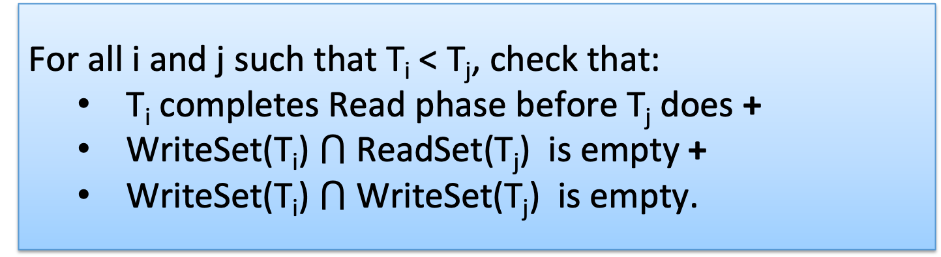
Example: Optimistic CC
T1: R(A), W(A), R(B), W(B)
READ VALIDATE WRITE
T2: R(A), W(A), R(B), W(B)
READ VALIDATE WRITE
Validation of T2:
  Test 1: fails Test 2: fails Test 3: ???
For all i and j such that T_{i} < T_{j}, check that:
  T_{i} completes Read phase before T_{j} does +
  WriteSet(T_{i}) $⋂$ReadSet(T_{j}) is empty +
  WriteSet(T_{i}) $⋂$WriteSet(T_{j}) is empty.

Slide 46
Example: Optimistic CC
T1: R(A), W(A), R(B), W(B)
READ VALIDATE WRITE
T2: R(A), W(A), R(B), W(B)
READ VALIDATE WRITE
Validation of T2:
  Test 1: fails Test 2: fails Test 3: fails
T2 gets restarted once T1 is completely finished

Slide 47
Comments on Validation
Assignment of txn id, validation, and the Write phase are inside a critical section!
  Nothing else goes on concurrently.
  If validation/write phase is long, major drawback!
Optimization for Read-only txns:
  Shorter critical section
  (because there is no Write phase).

Slide 48
Overheads in Optimistic CC
Record read/write activity in ReadSet and WriteSet per txn.
  Must create and destroy these sets as needed.
Check for conflicts during validation, and make validated writes “global”.
  Critical section can reduce concurrency.
Optimistic CC restarts txns that fail validation.
  Work done so far is wasted.
  Requires clean-up.
Notes:
If a long cleanup, that’s a major drawback.

Slide 49
Timestamp-based CC
Optimistic CC: Timestamp ordering is imposed on transactions, and validation checks that all conflicting actions occurred in the same order.
Timestamp-based CC
  Continuous validation – not a distinct phase
  Keep read and write timestamps per object, and starting timestamp of each txn
  Compare txn timestamp with read/write timestamps of the objects in order to decide between:
    Continue, Abort, Commit, Skip write
Continuous, per-object validation
Notes:
1.18 before this slide

Slide 50
Timestamp-based CC
Idea:
Txn timestamp TS ← begin time
Object: read-timestamp (RTS) and a write-timestamp (WTS)
  If action a_{i} of txn T_{i} conflicts with action a_{j} of txn T_{j}, and TS(T_{i}) < TS(T_{j}), then a_{i} must occur before a_{j}. Otherwise, restart violating txn.
  Use RTS, WTS to detect conflicts.
Object | Read-timestamp | Write-Timestamp
A | 10 | 4
B | 15 | 13
… | … | …

Slide 51
When txn T wants to READ Object O
TS(T) < WTS(O): violates timestamp order of T w.r.t. writer of O.
  Abort T and restart it with a new, higher TS.
TS(T) >= WTS(O):
  Allow T to read O.
  Reset RTS(O) to max(RTS(O), TS(T))
Change to RTS(O) on reads must be written in some persistent fashion → overhead.
Notes:
If T restarted with the same TS it will fail again! Contrast use of timestamps in 2PL for deadlock prevention.
If you read a value whose is written after you started, it violates the ordering in time! So, you need to abort!

Slide 52
When txn T wants to write Object O
TS(T) < RTS(O): violates timestamp order of T w.r.t. reader of O → abort and restart T.
TS(T) < WTS(O) → violates timestamp order of T w.r.t. writer of O. → ???
  Thomas Write Rule: Outdated write → Safely ignore the write –it’s as if the write happened before and was overwritten
  need not restart T!
  Allows some serializable schedules (correct) that are not conflict serializable.
Else, allow T to write O (and update WTS(O)).
Notes:
Thomas write rule: T’s write is effectively followed by another write, with no intervening reads.

Slide 53
Timestamp-based CC and Recoverability
Unrecoverable schedules are possible
Solution
  Make changes of T1 in a memory buffer and block T2 from committing
  Write changes to disk ONLY at commit
T1 T2
W(A)
R(A)
W(B)
Commit
Abort

Slide 54
Outline
Transactions & Concurrency Control
  ACID & Transaction Schedules
  Concurrency control protocols
    Pessimistic
    Optimistic
  Multi-version concurrency control

Slide 55
Multiversion Concurrency Control
Goal: A transaction never waits on read!
Idea
  Maintain several versions of each database object (multi-version), each with a read and a write timestamp.
  Transaction T_{i} reads the most recent version whose write timestamp precedes TS(T_{i}),
  i.e., WTS(O)<TS(T_{i}).
Multiversioning is a storage mgmt concept!
Combine with CC => MVTO, MVOCC, MV2PL
Notes:
OCC: you want to read but readset intersects with the writeset
Timestep-based CC: you want to read it, but WTO is less than RTO, so you need to abort and restart.
… → Bad for readings. Readings should be able to just move forward. Especially read-only transactions…

Slide 56
Multiversion Concurrency Control
MVCC lets writers make a “new” copy while readers use an appropriate “old” copy:
Current
versions of
DB objects.
Older versions that
may be useful for
some active readers.
O
O’
O’’
MAIN
SEGMENT
VERSION POOL

Slide 57
MV + Timestamp Ordering (MVTO)
For each version
WTS: the timestamp of the txn that created it
RTS: the timestamp of the txn that last read it
Versions are (usually) chained backward; we can discard versions that are “too old to be of interest” (i.e., garbage collection).
Each txn is classified as Reader or Writer.
  Writer may write some object; Reader never will.
  Txn declares whether it is a Reader when it begins.
Readers are always allowed to proceed.
Notes:
MVCC uses timestamps (TS), and incrementing transaction IDs, to achieve transactional consistency.
READS
--------
MVCC ensures a transaction (T) never has to wait to Read a database object (P) by maintaining several versions of the object.
Each version of object P has both a Read Timestamp (RTS) and a Write Timestamp (WTS) which lets a particular transaction Ti read the most recent version of the object which precedes the transaction's Read Timestamp RTS(Ti).
WRITES
---------
(Req1: “No active xaction holding lock of most_recent_version”)
If transaction Ti wants to Write to object P, and there is also another transaction Tk happening to the same object, the Read Timestamp RTS(Ti) must precede the Read Timestamp RTS(Tk), i.e., RTS(Ti) < RTS(Tk), for the object Write Operation (WTS) to succeed (i.e., Ti says “I read it first – I got dibs).
A Write cannot complete if there are other outstanding transactions with an earlier Read Timestamp (RTS) to the same object. Like standing in line at the store, you cannot complete your checkout transaction until those in front of you have completed theirs.
(Req2: “No later transaction depends on the old value”)
Every object (P) has a Timestamp (TS), however if transaction Ti wants to Write to an object, and the transaction has a Timestamp (TS) that is earlier than the object's current Read Timestamp, TS(Ti) < RTS(P), then the transaction is aborted and restarted.
Otherwise, Ti creates a new version of object P and sets the read/write timestamp TS of the new version to the timestamp of the transaction TS=TS(Ti).

Slide 58
Reader txn
For each object to be read:
  Finds newest version with WTS < TS(T): Starts with current version in the main segment and chains backward through earlier versions.
  Updates RTS to MAX(RTS, TS(T)).
Reader txns are never restarted.
old new
WTS timeline
T
Readers always proceed
Notes:
TS assigned at startup time

Slide 59
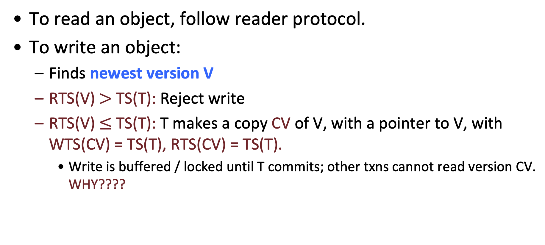
Writer txn
To read an object, follow reader protocol.
To write an object:
  Finds newest version V
  RTS(V) $>$ TS(T): Reject write
  RTS(V) $≤$ TS(T): T makes a copy CV of V, with a pointer to V, with WTS(CV) = TS(T), RTS(CV) = TS(T).
    Write is buffered / locked until T commits; other txns cannot read version CV. WHY????
Writers create new copy
(…if no younger transaction has read the data)
(…and if no active xaction holds V’s lock )
Notes:
other Txns cannot read version CV. WHY???? Because if they would use it, we might have unrecoverable schedules in the case T aborted.

Slide 60
Bottlenecks
Lock thrashing
  2PL, Strict 2PL
Timestamp allocation
  All T/O algorithms + deadlock prevention
Memory allocation
  MVCC, OCC
Notes:
Clearly there is no best protocol! What does it depend on? Think of concrete scenarios where each concurrency protocol suffers!

Slide 61
Improving performance of txn
Goal is to
reduce conflicts
reduce time spent on each transaction
Three key approaches
Stored procedures --> faster
Prepared statements --> precompiled
Query batches --> batch locking

Slide 62
Snapshot isolation
Snapshot isolation (SI) is the most popular isolation guarantee in real DBMS.
  all txn reads will see a consistent snapshot of the database
  the txn successfully commits only if no updates it has made conflict with any concurrent updates made since that snapshot.
SI does not guarantee serializability!
  SerializableSI: Stronger, more conservative protocol
Implemented in Oracle, MS SQL Server, Postgres.
Notes:
In practice snapshot isolation is implemented within multiversion concurrency control (MVCC), where generational values of each data item (versions) are maintained
In principle, one can use MVCC to implement a weaker isolation level too (Read Committed).
Read Committed. At Read Committed level, MVCC-based DB implements reads using snapshots taken at the moment of the read query issued. Writes still request write (exclusive) lock. At Read Committed level for MVCC-based databases, just like with Read Committed for lock-based DBs, “dirty reads” are not possible, but non-repeatable reads are possible. However, unlike with lock-based DBs, with MVCC-based databases writers do not block readers, and vice versa.
Repeatable Read/Serializable. At Repeatable Read isolation level (which usually – though not always – coincides with Serializable isolation level), MVCC-based DB implements reads using snapshots taken at the moment of beginning of the transaction. As a result, none of “dirty reads”, “non-repeatable reads”, and “phantom reads” are possible (at the cost of keeping more snapshots, especially if the longest of your transactions is long enough). Writes still request write lock. In addition, there is a special kind of failure which is specific for this isolation level with MVCC: the failure happens if our current transaction is trying to modify a row which has already been modified by another transaction after current transaction started. This phenomenon is known as a “serialization failure”

Slide 63
Snapshot isolation
Conceptually, txn works on a copy of the db made at txn start time.
  Very expensive → not implemented that way but still expensive.
  Guarantees that reads in the txn see a consistent version of the db.
At commit time, verify that the values changed by the transaction have not been changed by other transactions since the snapshot was taken.
Write skew anomaly
  Not serializable, but permitted by snapshot isolation!
T1: R(X)R(Y) W(X) C
T2: R(X)R(Y) W(Y) C
Notes:
Write skew anomaly: example with marbles 2 black, 2 white. Each transaction switches the marbles of one of the colours only. At the end we end up to a schedule that is NOT serializable.

Slide 64
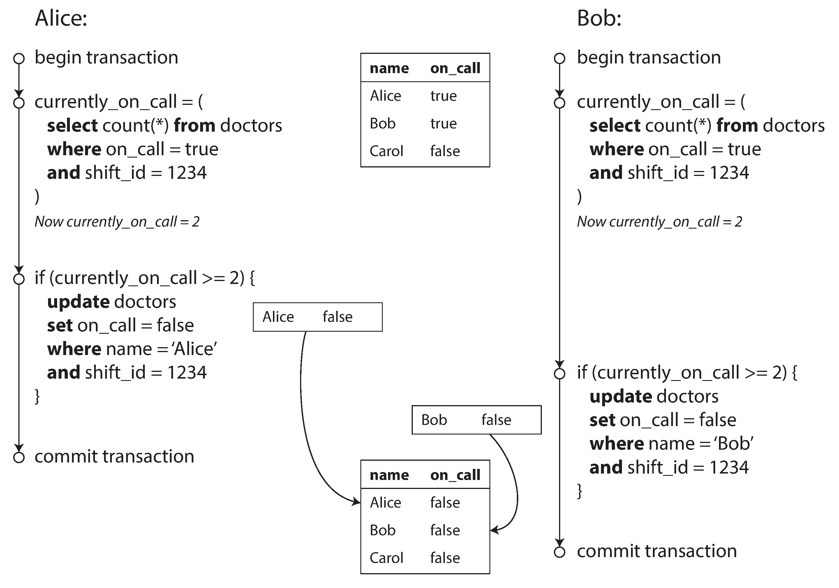
Write skew – (more concrete) example
[Source: Martin Kleppmann]

Slide 65
Discussion
SI is related to optimistic CC, in that
  Conceptually, snapshots are created at txn start.
  There is an analysis phase at the end to decide whether a transaction may commit (do writesets overlap?).
Multiversion CC is a way to implement
(a stronger) snapshot isolation.
Notes:
SI is MVCC where not all WR conflicts are appropriately caught.
WR conflicts are dirty reads – read something that is written but not yet committed..

